Slide 1

Access Control
Group 3
Karmdeep Kaur
Dwity Gohil
Ripunjoy Madhab buddha

Slide 2

what is access control?
Access control systems deliver basic security features that regulate user permissions. They make use of technologies such as passwords, biometrics, and security certificates, among others. This is considered one of the most important processes in your organization that help minimize the risks of identity theft and fraud, credential theft, and ransomware attacks.

Slide 3
Access control based on The Three (3) A’s (and One I) of Access Control
Access control systems are a fundamental part of any organization’s identity-proofing. Depending on the software or tool, the process is triggered when a person attempts to identify themselves in the system.
To better understand access control, we can take a deeper look into the four basic elements—identification, authentication, authorization, and accountability—and how they make the framework of this fundamental security feature.

Slide 4
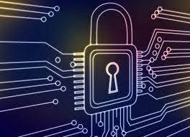
Identification – Identification is the starting point, where the users provide information about their identity. Today’s systems use authentication factors like fingerprint, retinal, or facial scans, which can be used to validate them in the system.

Slide 5
How Is Identity Verified?
A secure identity should be distinct in the sense that it should be possible for two users to identify themselves clearly. In the context of account monitoring, this is very significant. If the authentication systems are disconnected, it is feasible for identities to be duplicated.
The list that follows highlights the key concepts of identity.
Identities should be unique. Two users with the same identity should not be allowed.
2. Identities should be nondescriptive. It should not be possible to infer the role or function of the user. For example, a user called “Admin” represents a descriptive identity, whereas a user called “o1337ms1” represents a nondescriptive identity.
3. Identities should be securely issued. A secure process for issuing an identity to a user needs to be established.
4. Identities can be location-based. A process for authenticating someone based on his or her location.

Slide 6
Authentication – Authentication focuses on users providing proof of identity before being granted access to the system. Verification, which ideally is a multi-factor authentication process, proves that they are whom they claim to be. Entering a password, using a digital or physical key, and providing a biometric measure for accuracy are some of the ways to do this effectively.
The disadvantage of using this method is that once the information is lost or stolen (for example, if a user’s password is stolen), an attacker would be able to successfully authenticate.

Slide 7
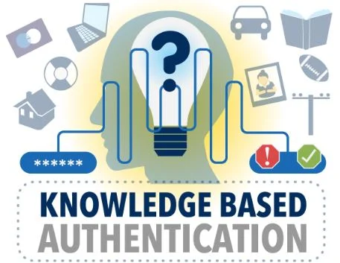
Authentication by Knowledge –
When the user offers a secret that only they know, that is known-only authentication by knowledge. A password, PIN code, or security question provided by the user would be examples of knowledge-based authentication.

Slide 8
Authorization – When a user has successfully established their identity, pre-determined permissions are granted to them during the authorization stage. The level of clearance that should be provided is determined by the reference monitor or authorization matrix, which also stores and transmits control information.
Default access privileges will be set to default deny (deny all).
Access to information and information systems must be limited to personnel and processes with a need-to-know to effectively fulfill their duties.
Access permissions must be based on the minimum required to perform the
job or program function.
4. Information and information system owners are responsible for determining access rights and permissions.
5. The Office of Information Security is responsible for enforcing an authorization process.
6. Permissions must not be granted until the authorization process is complete.

Slide 9

Authentication by Ownership or Possession –
With this type of authentication, the user is asked to provide proof that he owns something specific—for example, a system might require an employee to use a badge to access a facility. Another example of authentication by ownership is the use of a token or smart card.
Possession – The most common of the four is the one-time passcode sent to a device in the user’s possession.

Slide 10
Authentication by Characteristic –
Authentication by characteristic, often known as a biometric attribute, authentication verifies the user based on a physical or behavioral characteristic. The following physical or physiological traits are the most prevalent:
1. Fingerprint
2. Face recognition
3. Retina and iris
4. Palm and hand geometry
5. Blood and vascular information
6. Voice recognition

Slide 11
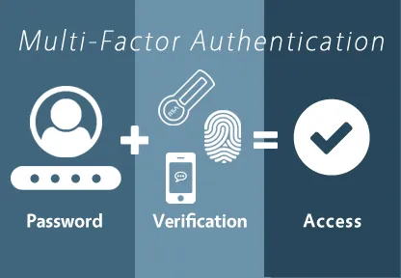
Multi-Factor Authentication – When only one factor is provided, it is known as single-factor authentication. The password is the single-factor authentication technique that is used the most. When two or more factors are presented, it is considered multifactor authentication. When two or more of the same kind of factors are presented, this is known as multilayer authentication.

Slide 12

Accountability or Audit – Accountability or audit are the last two components of the access control system. Your system can offer logs at this point so that use and permissions can be audited. By doing this, you can track what happened if something goes wrong, including what data was accessed or downloaded and how long each task took.
An authorization policy should implement two concepts:
Implicit deny: If no rule is specified for the transaction of the subject/object, the authorization policy should deny the transaction.
2. Need-to-know: A subject should be granted access to an object only if the access is needed to carry out the job of the subject.

Slide 13
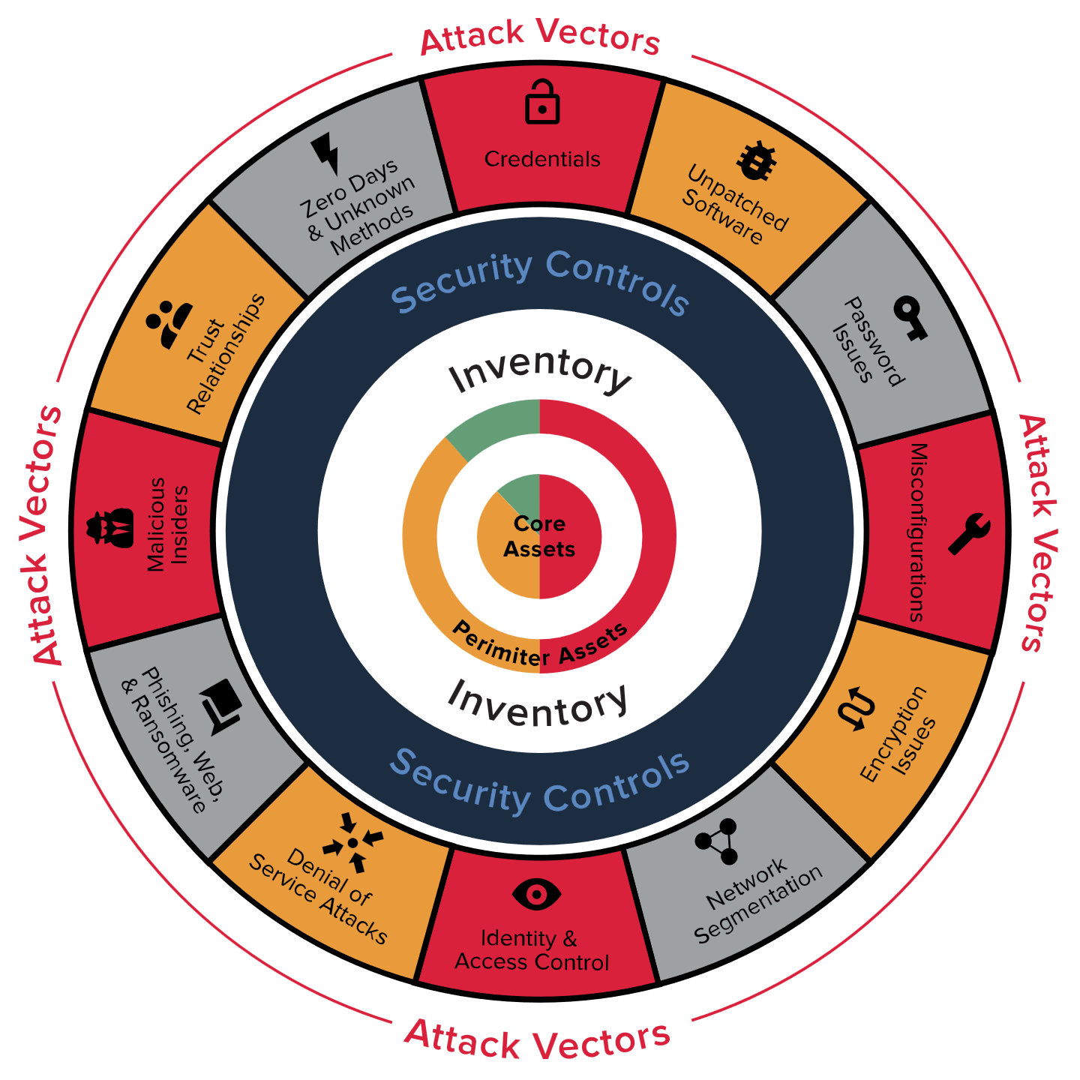
What Is a Security Posture?
A security posture is an organization’s approach to access controls based on information about an object, such as a host (end system) or network.

Slide 14
There is a concept called network access control (NAC) in which networking devices such as switches, firewalls, wireless access points, and others can enforce policy based on the security posture of a subject, in this case, a device trying to join the network.
NAC can provide the following:
Identity and trust
Visibility
Correlation
Instrumentation and management
Isolation and segmentation
Policy Enforcement
Open and secure are the two primary stances. Open, often known as default allow, denotes that access that isn't expressly prohibited is allowed. Secure, also known as default deny, denotes that any access that is not explicitly permitted is prohibited. In actual usage, default deny indicates that access is blocked until a rule, access control list (ACL), or setting is changed to permit access.

Slide 15

Principle of Least Privilege and Separation of Duties –
The principle of least privilege states that all users—whether they are individual contributors, managers, directors, or executives—should be granted only the level of privilege they need to do their jobs, and no more.
The software can benefit from the same idea of least privilege. For instance, applications or processes running on a system should only have access to the resources necessary to complete their tasks. They shouldn't have root access.

Slide 16
Infrastructure Access Control
It is defined as interconnected group of host and devices which is mostly distributed to different locations and offices.
Access to those infrastructure brings Infrastructure Access Control which includes – physical, logical, border, communication mechanism, host security which continues monitoring with must generated response…

Slide 17
Why Segment a network
The process of logically classifying network resources, applications, and assets is known as network segmentation. The ability to implement different services, authentication requirements, and security measures is made possible through segmentation.
Network segments includes the following types –

Slide 18
Enclave Network
It is a segment of an internal network which requires higher degree of protection. Internal accessibility is restricted through firewalls, VPNs, VLANs and network control devices.

Slide 19
Trusted Network (Wired / Wireless)
Internal network is accessible to authorized user only. External accessibility is restricted to the use of firewalls, VPNs, IDS, IPS. Internal accessibility may be restricted to VLANs and NAC devices.

Slide 20
Semi Trusted Network
It is designed to be internet accessible. Hosts are generally located in DMZ. Internal and external accessibility is restricted through the use of firewalls, VPNs, IDS, and IPS.

Slide 21
Guest Network
It is specifically designed for the use of visitors to connect to the internet. There is no access from guest network to trusted network.

Slide 22
Untrusted Network
A network outside of security control.

Slide 23
Technologies used to segment a Network
Virtual LANs (VLANs)
Security Group Tagging (SGT)
VPN Routing and Forwarding (VRF)
vMicro-segmentation at the virtual machine level
Micro-segmentation for containers

Slide 24
Layered border security
Layer security: Different security measures to work in tandem with a single focus.
Layered border security: Protection of the internal network from external controls. Which includes the controls like firewalls, VPNs, IDS, and IPS.

Slide 25
Firewalls
It controls the flow of traffic in the network which is mandatory. Without firewalls, the network is completely exposed and can be compromised.
Firewalls are handled and configured with procedures and rule sets to control incoming and outgoing traffic.

Slide 26
The process used to allow or block traffic includes:
Simple packet filtering techniques
Application Proxies
NAT
Stateful inspection firewalls
Next-gen context-aware firewalls

Slide 27
Intrusion Detection and Prevention
When malicious activities masquerade legitimate traffic these are used
IDS is a passive to analyze traffic to detect unauthorized access, and stressful protocol analysis and if it detects anything IDS generates an email, message or text alert.
IPS is an active device which seats in line with traffic and responds to identify threads by disabling connection, dropping packets or deleting malicious content.

Slide 28
Technologies used by IDS/IPS
Network-based: Monitors network traffic for a specific segment, and device and analyze activities.
Wireless IDS/IPS: Monitors wireless network traffic and analyzes activities and protocols.
Network behavioural analysis: It examines the traffic to identify threats, information flow, DDOS, malware and policy violations.
Host-based IDS/IPS: It monitors every single host and its events.

Slide 29
From these technologies, it has 4 decision states –
True positive: It correctly identifies an issue.
True Negative: It correctly identifies normal traffic.
False Positive: Incorrectly identifies normal activity as an issue
False Negative: Incorrectly identifies an issue as normal activity.

Slide 30
Network-Based IDS/IPS uses these detection methodologies
Pattern matching and stateful pattern matching recognition
Protocol analysis
Heuristic-based analysis
Anomaly-based analysis
Correlation protection capabilities based on threat intelligence

Slide 31
Content filtering & whitelisting/Backlisting
To prevent insider requests that could lead to the propagation of malware, data exfiltration, participation in peer-to-peer (P2P) networks, and viewing of inappropriate or unlawful content, controls must be in place. The insider request could be a reaction to a malicious command or directive or it could originate from authenticated authorized users. As was previously said, outbound traffic can and should be constrained by source and destination addresses, ports, and protocols using border device egress filters. Self-generated, open-source source, or subscription-based IP whitelists and/or blacklists can be used in addition to the filters.
Whitelist: Sites where access is allowed
Blacklist: Where access is denied
It commonly blocks the entire range of IPS specific to geographic locations
Restrict the access by content categories.

Slide 32
Border device administration and management
Everything has to be monitored- Logs and alerts must be monitored and analyzed (successful and unsuccessful both)
Policies need to be updated as per requirements
Detail examination of all changes since the last review
External pen testing used to verify the device performance

Slide 33
Blue teams: Defenders of the corporate network which includes SOC, CSIRTS, Infosec teams
Red Teams: Ethical hackers, Pen testers who identify vulnerabilities, attack detection and response capability of the device.
Purple Team: When Red and Blue teams aligned forces to completely defend the organization.

Slide 34
Remote access security
It is getting common increasingly that it has become normal now
It has controls like authentication that must be chosen carefully based on network-segmented information and classification that is accessible.
It follows CIA triads
Restricted information can’t be accessible to unauthorized parties, detecting good and bad modifications and ensuring the user can access required resources
It must include physical control of client devices.

Slide 35
Remote access technologies
VPN: Secure tunnel for transmitting data through the internet.
Achieved through tunnelling and encryption. To provide high security without the high cost of private lines. It is connected between physical or remote sites.

Slide 36
Single centralized interface which sends data to clients’ device, it is stored temporarily which limits access

Slide 37
Remote access authentication and authorization
Implement mutual authentication so they can verify legitimacy before providing authentication credentials.
MFA is required for access
Additionally user should require authentication periodically in remote access devices, they should ensure if they made the base line required for internal systems.

Slide 38
Network access control
Used to check remote access device based on its criteria, if it doesn’t meet a specific criteria access is denied.

Slide 39
Teleworking access control
Work flexibility arrangement under which employee performs his duties and responsibilities such as positions and other authorized activities from work site to location to work.

Slide 40
Benifits
Increased motivation and productivity
Reduction in vehicle pollution
Improved work-life balance
Reduced dependency on imported oils
New opportunities
Establishment of distributed workflows

